Slide 1
Contamos
AQUILO QUE VALORIZAMOS

Slide 2
ALVO
DO
DEPTO. DE
MORDOMIA CRISTÃ?
QUAL É O
Notes:
The answer to those crucial questions will depend on what we understand as the department’s VISION and MISSION.

Slide 3
O QUE VALORIZAMOS
QUAL É A COISA QUE MAIS VALORIZAMOS COMO O RESULTADO DE NOSSO TRABALHO?
Notes:
The answer to those crucial questions will depend on what we understand as the department’s VISION and MISSION.

Slide 4
POR QUE É IMPORTANTE TER UMA VISÃO?
Ajuda a visualizar os resultados desejados.
É crucial para estabelecer uma estratégia.
Provê alvos mensuráveis.
Notes:
It is told that someone asked Michelangelo about what he was carving out of a huge granite block. “A horse,” he answered. “But how can you carve a horse out of a block of granite!” that person answered in amazement. “It’s easy”, said Michelangelo. “My task is just to remove what is not the horse.” Interestingly, he could visualize a horse inside that granite block, and that vision allowed him to remove everything that wouldn’t pertain to it. Having a vision was crucial to molding his work strategy and shaping the outcome.

Slide 5
QUAL DEVERIA SER A VISÃO DO DEPARTAMENTO DE MORDOMIA CRISTÃ?
Notes:
It is also extremely important for us to have a clear vision of what we expect as the outcome of our work in the Stewardship Department. Should it be to have the church’s safes full of money, or to lead people to “fear God and give glory to Him, for the hour of His judgment has come” (Revelation 14:7)? Should pastors and spiritual leaders become just materialistic fundraisers or spiritual soul-seekers in Christ’s behalf? The answer to those questions will determine the strategy that we will adopt.

Slide 6
A VISÃO DEVERIA SER…
Os cofres da igreja cheios de dinheiro?
Pastores e líderes espirituais se tornando em levantadores de fundos?

Slide 7
OU A VISÃO DEVERIA SER…
Membros da igreja temendo “a Deus… porque…” (Apoc. 14:7)?
Líderes trabalhando em favor de Cristo, preocupados com a salvação de pessoas?

Slide 8
Uma visão apropriada para Mordomia Cristã só pode ser estabelecida depois que a compreensão de o que é Mordomia Cristã seja desenvolvida!
Notes:
It is also extremely important for us to have a clear vision of what we expect as the outcome of our work in the Stewardship Department. Should it be to have the church’s safes full of money, or to lead people to “fear God and give glory to Him, for the hour of His judgment has come” (Revelation 14:7)? Should pastors and spiritual leaders become just materialistic fundraisers or spiritual soul-seekers in Christ’s behalf? The answer to those questions will determine the strategy that we will adopt.

Slide 9
MORDOMIA: DEFINIÇÃO (AMPLA)
“Mordomia é a administração
daquilo que
pertence a outrem.” Mel Rees
Notes:
An appropriate vision for the Stewardship Department will only develop after an understanding of what Stewardship is. An interesting definition says that “Stewardship is the management of that which belongs to another,” i.e., which belongs to God—the Owner of all things (Psalm 24:1-3; 1 Cor. 10:26).
Rees, Mel, Basic Stewardship Manual, General Conference Church Ministries, 1990, page 7.

Slide 10
MORDOMIA CRISTÃ: DEFINIÇÃO
“Mordomia é a tarefa designada por Deus
para o homem
para que este o reconheça como
Criador, Redentor, e Senhor,
e para que administre
Seus negócios no planeta Terra, guiado pelo princípio ‘Primeiro Deus’.”

Slide 11
BOM MORDOMO…
“É pessoa que reconhece a realidade e a penalidade de seu pecado individual
(Rom. 3:23-24; 6:33),
aceita a morte de Jesus em seu favor (Rom. 6:33;
João 3:16), and accepts the lordship of Jesus (Luc 2:11),
negando o “eu”
(Gal. 2:20; Luc 9:23-25).
Esta pessoa vive em íntima relação com Ele
(João 15:1-5),
confiando nEle (Heb. 11:6);
através da habitação do Espírito
torna-se em uma nova criatura (Ez. 36:26; 2 Cor. 5:17),
e serve a Deus
como seu representante,
administrando Suas coisas no Planeta Terra
(1 Cor 3:9; 2 Cor 5:20) guiado pelo princípio ‘Primeiro Deus’.”

Slide 12
COMO ENCONTRAR FELICIDADE E SIGNIFICADO?
Somente através da administração da própria vida, e dos ambientes social e material de acordo com as especificações divinas.
Mas como administrar a vida e aquilo que a cerca?

Slide 13
NOSSA MENSAGEM PARA OS ÚLTIMOS DIAS:
“… para cada nação, língua, tribo e povo.” Apoc. 14:6
“… Temei a Deus e dai-Lhe gloria porque é chegada a hora do Seu juízo.” Apoc. 14:7
Mark Finley: “Temer a Deus é faze-Lo primeiro em nossas vidas.” As Três Mensagens Angélicas (LES, 18 de Abril de 2023), pag 33 (Inglês).

Slide 14
PRINCÍPIO-CHAVE DE JESUS
“Mas buscai primeiro o reino de Deus e Sua justiça, e todas estas coisas vos serão acrescentadas.”Mateus 6:33
Notes:
Jesus stated a key principle of management (or stewardship) that, if practiced, will bring everything else into the right perspective. He promised that if we “seek first the kingdom of God and His righteousness… all these things shall be added to you.” Matthew 6:33 (NJKV). True success in all areas of life can only be obtained by putting God first.

Slide 15
O QUE SATANÁS FEZ…
Seu “alvo... [é] levar os homens a pôr o eu em primeiro lugar...” CS, 24.
Este tipo de mentalidade, “enche o mundo de miséria e luta, pondo os seres humanos em desavença uns com os outros.” CS, 24.
Notes:
It is because Satan knows this, that his “aim has been to lead men to self first...”, instead of God first. And this kind of mindset “has filled the world with misery and strife…” becoming the main reason for environmental and economic problems, marriage failures, and the breakdown of any other social relations.
White, Ellen G., Counsels on Stewardship, page 24.

Slide 16
A ESSÊNCIA DA DEPRAVAÇÃO
“O egoísmo é a essência da depravação, e devido a se terem os seres humanos submetido ao seu poder, . . . Nações, famílias e indivíduos estão cheios do desejo de fazer do eu um centro.” CS, 24

Slide 17
COMO FAZER OPOSIÇÃO À OBRA DE SATANÁS?
Notes:
If Satan aims “to lead men to self first,” filling “the world with misery and strife,” we are called to partner with God in counterfeiting Satan’s work.

Slide 18
VISÃO:
“PESSOAS COLOCANDO PRIMEIRO DEUS.”

Slide 19
QUEM DEVE SE CONVIDADO(A)?
Apenas membros da igreja?
Ou “cada nação, tribo, língua e povo” são chamados a temer “a Deus e dai-lhe glória” (Apoc. 14:6, 7)?
Notes:
Not only church members are invited to put God first, but “every nation, tribe, tongue, and people” are called to “fear God and give glory to Him” (Revelation 14:6-7), recognizing Him while managing life and the spiritual, social, and material environments.

Slide 20
COMO COLOCAR PRIMEIRO DEUS?
Só no campo dos valores? (Subjetivo)
Ou Ele deve ter também a primazia em nossas práticas e programa diário? (Objetivo)
Notes:
And God should be put first not only in the realm of values but also be given primacy in our daily schedule and practices. You will find in the “I Promise” Commitment Card seven crucial points in which we are invited to trust God and partner with Him in His final mission.
Find the “I Promise” God First Commitment Card here: https://stewardship.adventist.org/commitment-card-promise

Slide 21
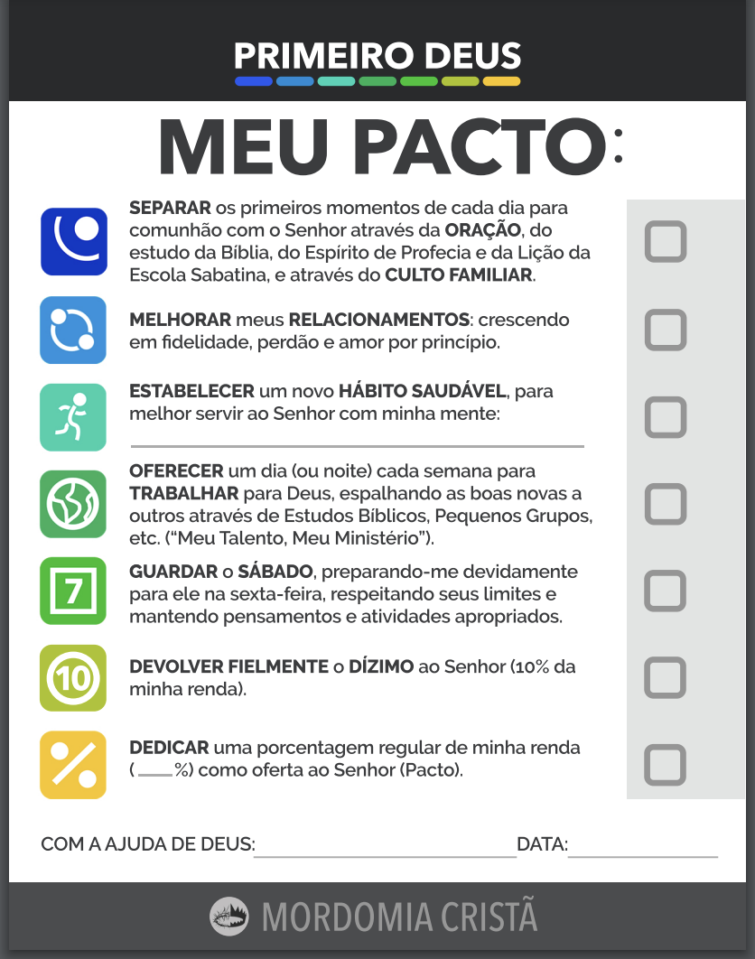
“MEU PACTO”
CARTÃO DE COMPROMISSO
https://stewardship.adventist.org/commitment-card-promise
Notes:
Find the “I Promise” God First Commitment Card here: https://stewardship.adventist.org/commitment-card-promise

Slide 22
ESTRATÉGIA
Princípio
Compromisso
(Mat 6:33)
Notes:
And because this vision, “People putting God first,” is broader than the scope of a single department, the Adventist Church has created many ministries or departments (like Education, Sabbath School & Personal Ministries, Health, Family Ministries, Women Ministries, just to mention some), all doing their part in nurturing people to embrace the principles of stewardship (or management) at large.

Slide 23
QUAL É A CONTRIBUIÇÃO ESPECÍFICA DO DEPARTAMENTO DE MORDOMIA CRISTÃ?
Notes:
Our mission statement has to do with the specific contribution of the Stewardship Ministries department to this broad “God first” vision, which should also be carried out by all other church departments. Since its inception, the Stewardship Department's mandate has been to focus, but not exclusively, on “inviting people to trust God as Owner and Provider, and to partner in His final mission through regular and systematic giving”.

Slide 24
MISSÃO:
“CONVIDAR PESSOAS A CONFIAR EM DEUS COMO PROPRIETÁRIO E PROVEDOR, E A ENTRAR EM SOCIEDADE COM ELE EM SUA MISSÃO FINAL ATRAVÉS DA DADIVOSIDADE REGULAR E SISTEMÁTICA.”
Notes:
Our mission statement has to do with the specific contribution of the Stewardship Ministries department to this broad “God first” vision, which should also be carried out by all other church departments. Since its inception, the Stewardship Department's mandate has been to focus, but not exclusively, on “inviting people to trust God as Owner and Provider, and to partner in His final mission through regular and systematic giving”.
There are some key elements in this mission statement. First, the Stewardship Department is not in the business of inviting people to “give” but to trust God, as Owner and Provider.
A second point to be highlighted is about partnering with God and acting as His agents on the Earth. This partnership, which is proposed by Him, embraces privileges and responsibilities, and also includes our finances (e.g. Proverbs 3:9-10; Malachi 3:10; 1 Corinthians 3:9; 16:2). In line with those Bible verses, Ellen G. White says for instance that “the Lord made a special covenant with men, that if they would regularly set apart the portion designated for the advancement of Christ’s kingdom, the Lord would bless them abundantly, so that there would not be room to receive…” She also adds that “if men will become channels through which heaven’s blessing can flow to others, the Lord will keep the channel supplied.”
The final emphasis in the mission statement is that people are invited to exercise trust in God primarily through regular and systematic giving. White, Ellen G., Counsels on Stewardship, page 77.
Idem, page 36.

Slide 25
POR QUE ESTA ÊNFASE NA DADIVOSIDADE
REGULAR E SISTEMÁTICA?
Notes:
Why have such an emphasis on regular and systematic giving? Why not simply suggest that people give always “after your heart”?

Slide 26
POR QUE NÃO DAR SEGUINDO O CORAÇÃO?

Slide 27
O CORAÇÃO HUMANO…
É “enganoso, acima de todas as coisas” (Jer. 17:9)
Notes:
Even though the heart may sometimes be rightly susceptible to being impressed by God, that is not generally the case. Those who trust too much in their hearts, always allowing their impressions or feelings to command their actions, frequently ignore that the heart is naturally selfish and “deceitful above all things” (Jeremiah 17:9).

Slide 28
NÃO SE PODE CONFIAR NOS IMPULSOS HUMANOS…
“… É o egoísmo o mais forte e mais generalizado dos impulsos humanos; a luta da alma entre a simpatia e a cobiça é uma luta desigual… Portanto, em nosso trabalho e nas nossas dádivas à causa de Deus, não é seguro ser dominado pelos sentimentos ou pelo impulso.” CS, 25
Notes:
Ellen G. White says that because “selfishness is the strongest and most general of human impulses… in our labors and gifts for God’s cause it is unsafe to be controlled by feeling or impulse.”
Ibidem, page 25.
Therefore, we are encouraged by God to “act from fixed principle, following the Saviour’s example of self-denial and self-sacrifice,” instead of acting purely upon feelings and impressions. At the same time, we need to pray for a change of heart, which is promoted by the indwelling of the Holy Spirit (Ezekiel 36:26-27)—a heart more inclined to do what is right, to “act from fixed principle.” Ibidem, page 25.

Slide 29
COMO ENTÃO DEVEMOS AGIR?
“… Devem os cristãos agir guiados por princípios fixos, seguindo o exemplo de abnegação e de sacrifício proprio do Salvador.” CS, 25
Notes:
Therefore, we are encouraged by God to “act from fixed principle, following the Saviour’s example of self-denial and self-sacrifice,” instead of acting purely upon feelings and impressions. At the same time, we need to pray for a change of heart, which is promoted by the indwelling of the Holy Spirit (Ezekiel 36:26-27)—a heart more inclined to do what is right, to “act from fixed principle.” Then, “the cause of benevolence would no longer be dependent on the uncertain gifts of impulse, and vary according to the changing feelings of men.”
Ibidem, page 25.
Ibidem, pages 199, 200.

Slide 30
O QUE ACONTECERIA COMO RESULTADO?
“… Não dependeria a causa da beneficência da incerteza de dádivas resultantes de impulso, e que variam segundo os mutáveis sentimentos do homem...” CS, 199, 200.
Notes:
Then, “the cause of benevolence would no longer be dependent on the uncertain gifts of impulse, and vary according to the changing feelings of men.”
Ibidem, pages 199, 200.

Slide 31
PORQUE AS POSSES SÃO TRANSPORTADORAS DE AFEIÇÕES…
Somos encorajados por Deus a colocar nossos recursos, regular e sistematicamente, onde queremos que nosso coração esteja (Mat 6:21).
Notes:
Because “possessions are carriers of affections”, we are encouraged by God to regularly and systematically place our resources where we want our hearts to be (see Matthew 6:21). Bomfim, Marcos F. (2020). Nurture and Heart Retention: a reliable predictor helps to prevent dropout; General Conference of the Seventh-day Adventists Nurture and Retention Committee (Ed.). Discipling, Nurturing, and Reclaiming: Nurture and Retention Summit (page 90). Silver Spring, MD: Review and Herald Publishing Association.

Slide 32
QUAL DEVEM SER A
REGULARIDADE E O SISTEMA?
Regularidade: Baseada na renda (Prov. 3:9).
Sistema: Proporcional à renda (Deut 16:17; 1 Cor 16:2; 2 Cor 8:12).
Notes:
And what should be the regularity and the system by which we give tithe and regular offerings? The regularity is determined by the receipt of an income or increase, and our primary giving system, even for offerings, is proportioned to the income, or percent based (see e.g. Deuteronomy 16:17, 1 Corinthians 16:2, and 2 Corinthians 8:12).

Slide 33
ESSE É A OFERTA CONHECIDA COMO
“PACTO”!
https://stewardship.adventist.org/promise-offerings
Notes:
Why have such an emphasis on regular and systematic giving? Why not simply suggest that people give always “after your heart”?

Slide 34
MUDANÇA DE PARADIGMA
Deus se torna o centro da dadivosidade.
“Pactuantes” não mais são dominados “pelos sentimentos ou pelo impulso”. CS, 25

Slide 35
MUDANÇA DE PARADIGMA
“Pactuantes” não mais dão como doadores, filantropos, para ajudar, patrocinar, ou apoiar algo ou alguém.
“Pactuantes” não mais dão apenas quando sentem que deveriam dar.

Slide 36
PARADIGM SHIFT
“Pactuantes” não mais anseiam por reconhecimento humano.
“Pactuantes”dão como uma resposta às bençãos de Deus, e não em expectativa das bênçãos.

Slide 37
COMO SABER…?
Se estamos tendo sucesso em convidar pessoas a confiar em Deus como Proprietário e Provedor, e a entrar em socidade com Ele em Sua missão final através da dadivosidade regular e sistemática?
Notes:
How do we know if we are succeeding in inviting people to trust God and partner in His final mission through regular and systematic giving? How do we assess our progress? Should we consider the increase in tithe and offering income in a congregation or field as an indicator of increased trust in God on the part of its members? Not at all.

Slide 38
COMO SABER…?
Será que o aumento da entrada de dízimos e ofertas pode ser considerado um indicador seguro de que está havendo um crescimento na confiança em Deus por parte dos membros da igreja?
Quais devem ser nossos alvos mensuráveis então?
Notes:
How do we know if we are succeeding in inviting people to trust God and partner in His final mission through regular and systematic giving? How do we assess our progress? Should we consider the increase in tithe and offering income in a congregation or field as an indicator of increased trust in God on the part of its members? Not at all.

Slide 39
QUE COISAS DEVEMOS CONTAR?
“Nós contamos o que valorizamos e valorizamos o que contamos.” Unknown.
Notes:
Tithe and offering income growth is not necessarily an indication of spiritual growth in a congregation. It may be just a reflection of the blessing that one single person has received in that congregation or field. And as our mission statement is focused on spiritual growth, instead of financial growth, we are supposed to count not money, but people’s participation, i.e., the proportion of those engaged in regular and systematic giving. As the saying goes, “we count what we value, and we value what we count”.

Slide 40
ALVO:
“AO COMEÇO DE CADA ANO, UM ADICIONAL DE 2% DO NÚMERO DE MEMBROS ESTÁ DIZIMANDO E DEVOLVENDO OFERTAS REGULARES E SISTEMÁTICAS (PACTO).”

Slide 41
AS PERGUNTAS MAIS IMPORTANTES
Qual é a proporção do total de membros que atualmente está entregando regularmente o dízimo e ofertas sistemáticas?
Esta proporção está crescendo ou diminuindo a cada ano?

Slide 42
OUTRAS PERGUNTAS IMPORTANTES
Qual a proporção do salário que em média os membros deste território/igreja entregam como “Pacto”?
Esta proporção está crescendo ou diminuindo?
Notes:
Those questions must be thoroughly answered, data must be accessed and plans accordingly devised, otherwise, the vision, “people putting God first,” will never be accomplished.
But how can we assess this information? The General Conference has made available the ACMS (Adventist Church Management System), which is able to synchronize and cross treasury and secretary information, revealing the current percentage of incognito members of a given congregation or field that are Promisors, or regular and systematic givers. If your field is already using that system, you can assess that information in seconds.
By primarily assessing people’s participation, stewardship leaders reveal that they want more than simply to promote an increase in the church’s financial income, as important as it may be for the accomplishment of Christ’s Great Commission. They want to see more and more people knowing God more intimately, trusting Him, learning how to live by faith, and finally populating heaven after Jesus’ second coming. Even so, come, Lord Jesus!
In 2022 the ACMS was already in use in 10 divisions and 89 unions.

Slide 43
JÁ OUVIU FALAR DO
ACMS?
ACMS = Adventist Church Management System
Em 2022 o ACMS já estava sendo usado por 10 divisões e 89 uniões!
Notes:
And God should be put first not only in the realm of values but also be given primacy in our daily schedule and practices. You will find in the “I Promise” Commitment Card seven crucial points in which we are invited to trust God and partner with Him in His final mission.
Find the “I Promise” God First Commitment Card here: https://stewardship.adventist.org/commitment-card-promise

Slide 44
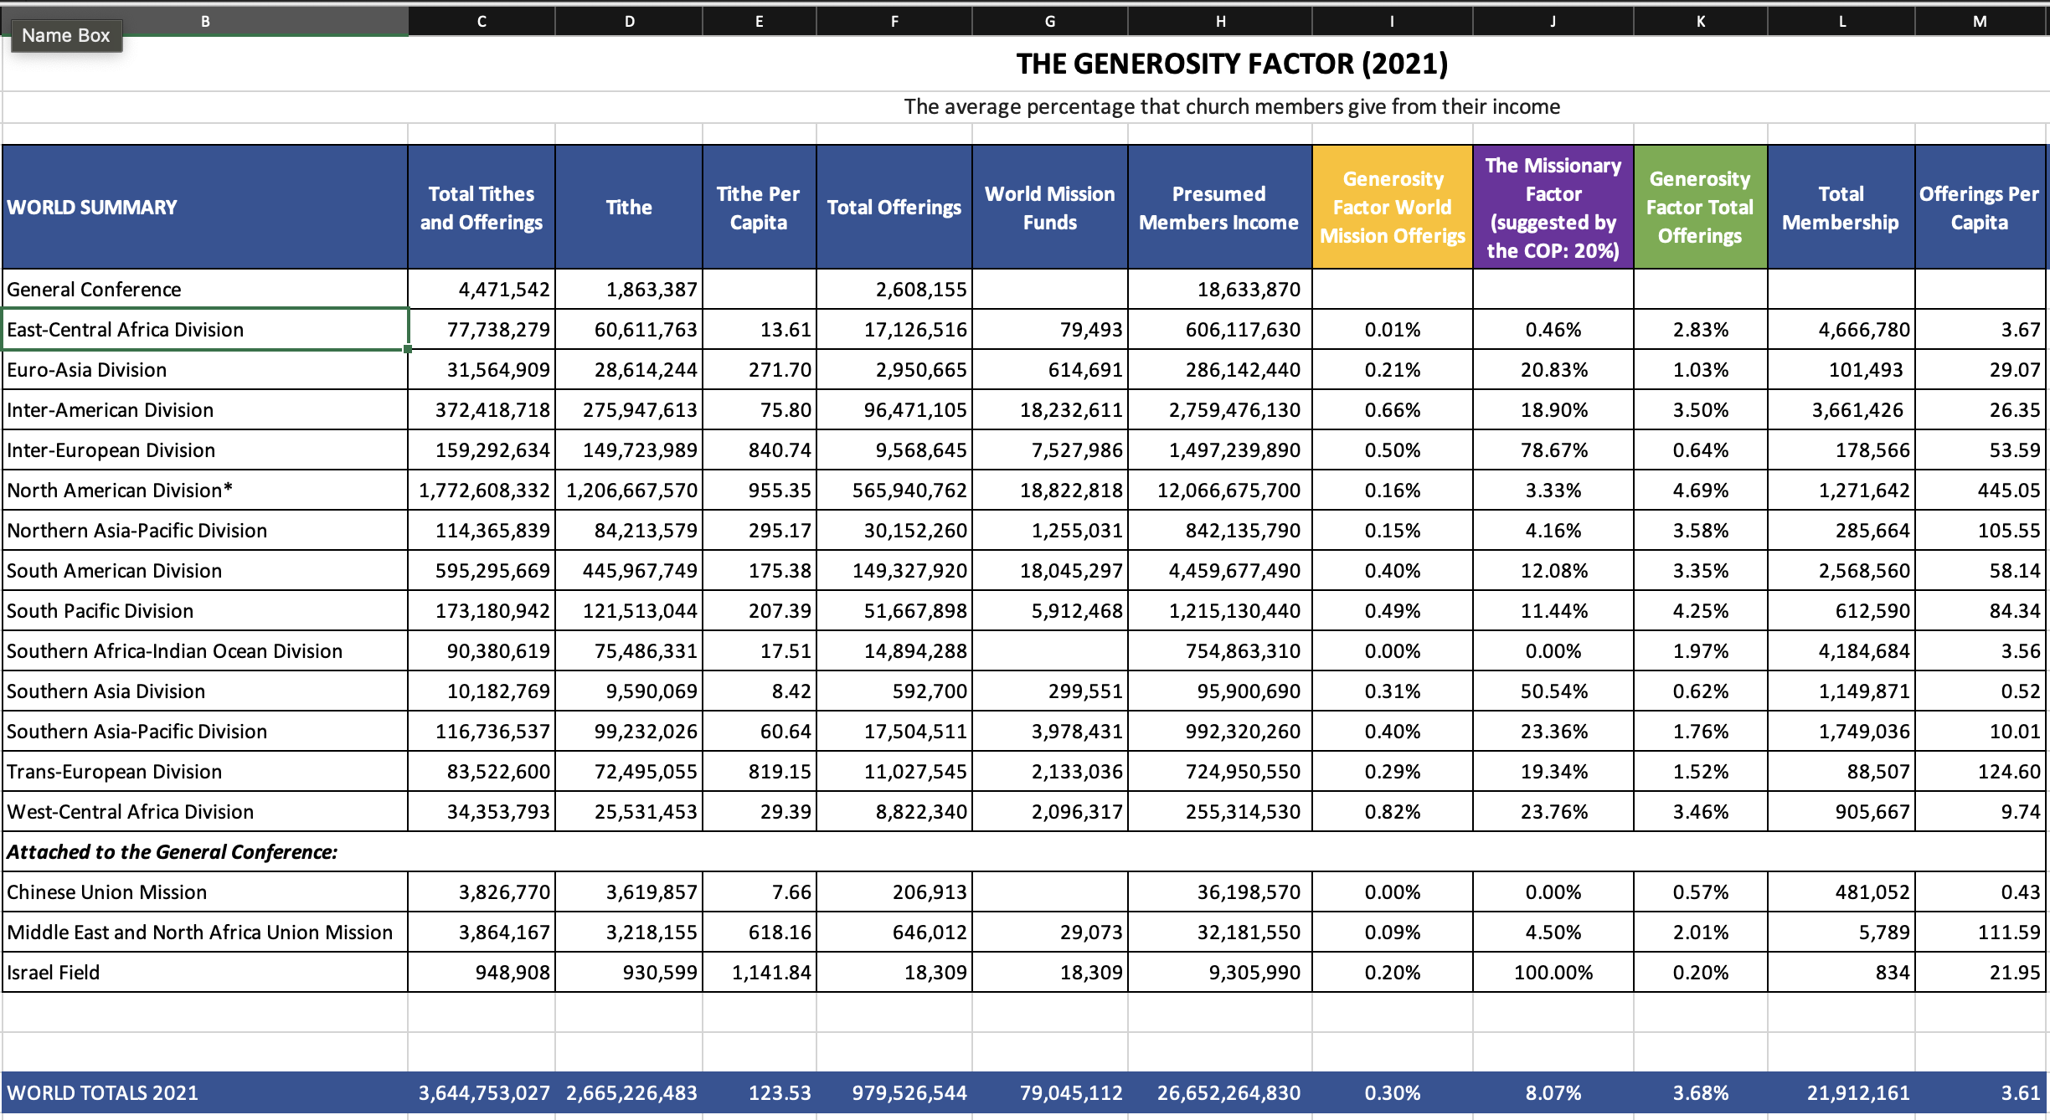
FATOR GENEROSIDADE - 2021

Slide 45
Ranking | Division/Field | Generosity Factor (Total Offerings)
1 | North American Division | 4.69%
2 | South Pacific Division | 4.25%
3 | Northern Asia-Pacific Division | 3.58%
4 | Inter-American Division | 3.50%
5 | West-Central Africa Division | 3.46%
6 | South American Division | 3.35%
7 | East-Central Africa Division | 2.83%
8 | Middle East and North Africa Union Mission (MENAUM) | 2.01%
9 | Southern Africa-Indian Ocean Division | 1.97%
10 | Southern Asia-Pacific Division | 1.76%
11 | Trans-European Division | 1.52%
12 | Euro-Asia Division | 1.03%
13 | Inter-European Division | 0.64%
14 | Southern Asia Division | 0.62%
15 | Chinese Union Mission | 0.57%
16 | Israel Field | 0.20%
2020 World Totals | General Conference | 3.70%
2021 World Totals | General Conference | 3.68%
FATOR GENEROSIDADE – 2021 (Total de Ofertas)

Slide 46
Ranking | Division/Field | 2021 Generosity Factor (Mission Offerings)
1 | West Central Africa Division | 0.82%
2 | Inter-American Division | 0.66%
3 | Inter-European Division | 0.50%
4 | South Pacific Division | 0.49%
5 | South American Division | 0.40%
6 | Southern Asia-Pacific Division | 0.40%
7 | Southern Asia Division | 0.31%
8 | Trans-European Division | 0.29%
9 | Euro-Asia Division | 0.21%
10 | Israel Field | 0.20%
11 | North American Division | 0.16%
12 | Northern Asia-Pacific Division | 0.15%
13 | Middle East and North Africa Union Mission | 0.09%
14 | Southern Africa-Indian Ocean Division | 0.00%
15 | Chinese Union Mission | 0.00%
16 | East-Central Africa Division | 0.01%
2020 World Totals | General Conference | 0.28%
2021 World Totals | General Conference | 0.30%
FATOR GENEROSIDADE – 2021 (Ofertas Missionárias)

Slide 47
Ranking | Division/Field | 2021 Missionary Factor (Mission Offerings)
1 | Israel Field | 100%
2 | Inter-European Division | 78.67%
3 | Southern Asia Division | 50.54%
4 | West-Central Africa Division | 23.76%
5 | Southern Asia-Pacific Division | 23.36%
6 | Euro-Asia Division | 20.83%
7 | Trans-European Division | 19.34%
8 | Inter-American Division | 18.90%
9 | South American Division | 12.08%
10 | South Pacific Division | 11.44%
11 | Middle East and North Africa Union Mission | 4.50%
12 | Northern Asia-Pacific Division | 4.16%
13 | North American Division | 3.33%
14 | East-Central Africa Division | 0.46%
15 | Southern Africa-Indian Ocean Division | 0.00%
16 | Chinese Union Mission | 0.00%
2020 World Totals | General Conference | 0.28%
2021 World Totals | General Conference | 0.30%
FATOR MISSIONÁRIO – 2021 (Total de Ofertas)
Notes:
Quanto do salário em media membros entregam como ofertas missionárias.

Slide 48
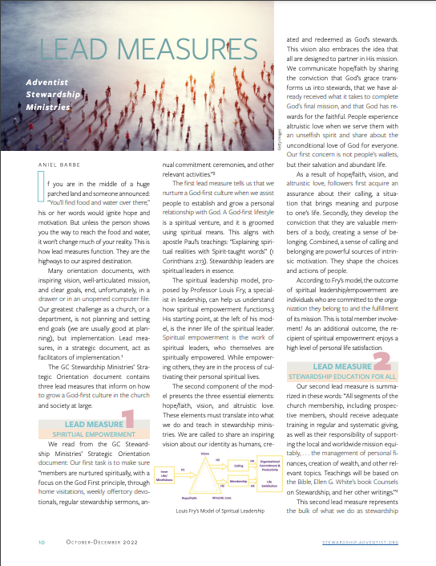
Próxima atividade: leia o artigo de Aniel Barbe sobre as três “Medidas Mestras”.
Responda à pergunta: Quais são as três medidas mestras e quais os recursos disponíveis para motivar pessoas a colocar Primeiro Deus regular e sistemáticamente?
Leia o artigo (em inglês) aqui (html).
O artigo completo da revista Mordomo Dinâmico (em Inglês, em PDF) aqui!
Notes:
And God should be put first not only in the realm of values but also be given primacy in our daily schedule and practices. You will find in the “I Promise” Commitment Card seven crucial points in which we are invited to trust God and partner with Him in His final mission.
Find the “I Promise” God First Commitment Card here: https://stewardship.adventist.org/commitment-card-promise

Slide 49
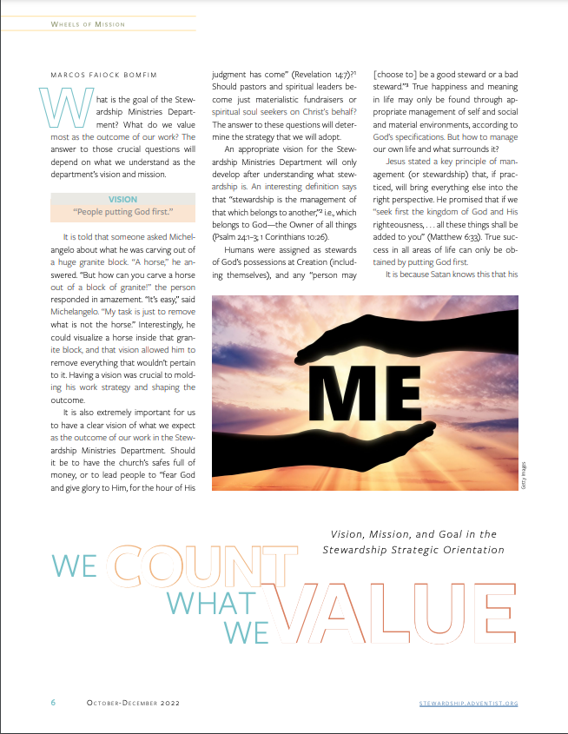
Leia o artigo “Nós Contamos o que Valorizamos” (em inglês) aqui!
O artigo completo da revista Mordomo Dinâmico (em Inglês, em PDF) aqui!
Notes:
And God should be put first not only in the realm of values but also be given primacy in our daily schedule and practices. You will find in the “I Promise” Commitment Card seven crucial points in which we are invited to trust God and partner with Him in His final mission.
Find the “I Promise” God First Commitment Card here: https://stewardship.adventist.org/commitment-card-promise

Slide 50
Asissta ao vídeo com esta apresentação (em inglês) aqui:

